Slide 1
Writing Tests with Pester
Adam Bertram / Ashley Mcglone

Slide 2
Why Bother with Testing?
"It takes up too much time.“
"What's the point?“
"It's just PowerShell."

Slide 3
Benefits Of Testing
PREVENTS REGRESSION BUGS
CREATES A "SNAPSHOT" IN TIME
DEFINES "WORKING"
THE BIG
RED BUTTON
ENABLES TRUST IN YOUR CODE
FORCES BETTER CODING PRACTICES

Slide 4
Testing "Layers"
ACCEPTANCE TESTS
INTEGRATION TESTS
UNIT TESTS

Slide 5
Testing is a Skill
"Functional" code and
test code are different
Good tests require
different thinking

Slide 6
Pester
1st
2nd
3rd
Created by
Jakub Jareš
Open Source
Installed with
Windows 10

Slide 7
Course Outline
Learning Pester
Pester Application
Module 1
Module 2
Module 3
Module 4
Getting Started
Writing Tests for PowerShell Tools
Writing Tests for the PowerShell Gallery
Test Automation with DSC and Build Pipelines
Setup
Syntax
Test design
Mocking
TestDrive
Code Coverage
Unit Tests
Code Refactoring
Testing Modules
Mocking objects
Testing exceptions
Integration Tests
PSScriptAnalyzer
Infrastructure Tests
Testing DSC Configurations

Slide 8
Installing Pester
Downloading
Installing
Exploring Commands

Slide 9
The Basics
Describe/Context blocks
Should assertions
Invoking test scripts

Slide 10
Using TDD to Build a Function
Test-Driven Development
Create tests for a function
Ensure those tests fail
Write code to make the tests pass
Project

Slide 11

Code Coverage
HOW MUCH CODE EXECUTED DURING TESTING
USED IN UNIT TESTING

Slide 12
Mocking
"OVERWRITES"
FUNCTIONS
ALLOWS CONTROL OVER CODE EXECUTION
USED IN UNIT TESTING

Slide 13
Writing Tests for PowerShell Tools
CSV --> AD sync tool
Script--> Refactor into functions --> Module
Full testing along the way

Slide 14

Writing Tests for the PowerShell Gallery
Module Manifest
Keys populated in module manifest
Pester tests
PSScriptAnalyzer tests pass

Slide 15
Test Automation with DSC and Build Pipelines
Infrastructure
Testing
Introducing
Test Automation

Slide 16

Test Domain Creator
Given a single VM, it creates
An Active Directory Domain
Groups
OUs
Users

Slide 17
A Simple Release Pipeline
Commit to Source Control
Invoke build
script
Build the things
Pass/Fail
build
Run test

Slide 18

What We've Learned
1
2
3
4
5
DIFFICULT
TO GET
STARTED
FORCES BETTER
CODE
TURNS SCRIPTS
INTO CODE
GROWS
TRUST
AUTOMATE
IT!

Slide 19
Demo Resources
http://bit.ly/mvapester

Slide 20
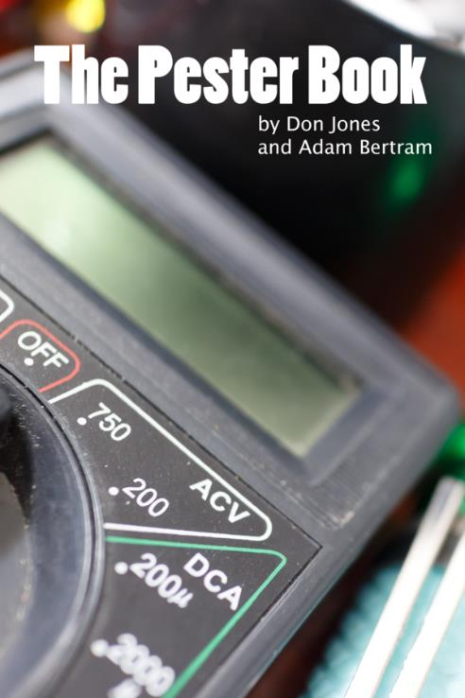
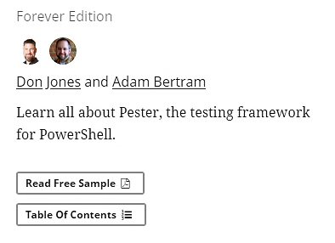
The Pester Book
https://leanpub.com/the-pester-book

